Slide 1
Human Computer Interfacing
CSE - 476
Chapter 1b
Imran Siddiqi
imran.siddiqi@mcs.edu.pk

Slide 2

Today’s Interface Hall of Shame
Where does it come from?
Microsoft Word
Problem?
  Four pairs of mutually exclusive options
  Check boxes?
Introduction

Slide 3

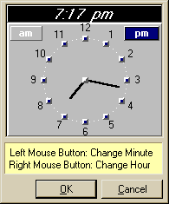
Today’s Interface Hall of Shame
Software Automate Pro
Interface: Entering schedule time for an event
How would you enter the time?
Click on Set time
Use the special clock control
Introduction

Slide 4
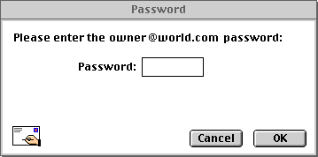
Today’s Interface Hall of Fame
Useful solution to a very common problem
Indicating that the state of the Caps Lock key may interfere with the processing of the password is a good idea
Introduction

Slide 5
Lecture Contents
Introduction
Human
  Input/Output Channels
  Human Memory
  Thinking
Introduction

Slide 6
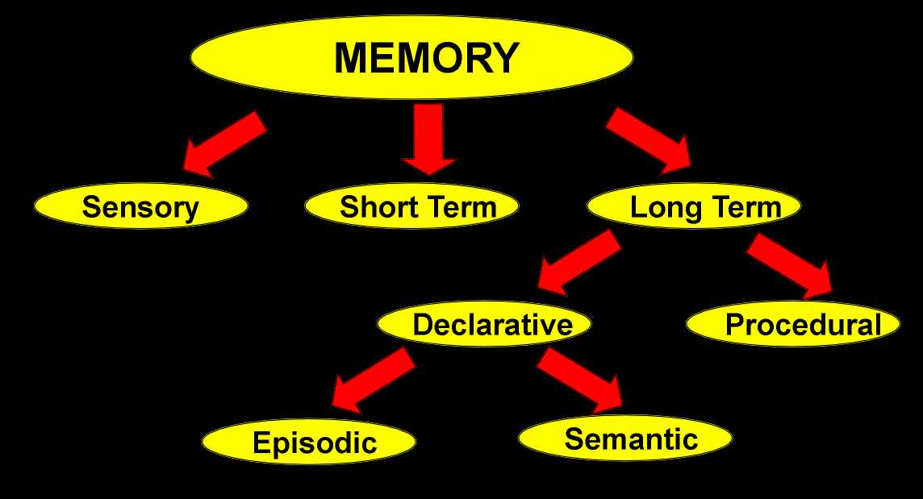
Human Memory
There are three types of memory functions
  Sensory Memory
  Short-term or working memory
  Long-term memory
Introduction

Slide 7
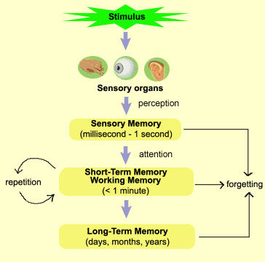
Human Memory
Introduction

Slide 8
Sensory Memory
Buffers for stimuli received through senses
  Iconic memory: visual stimuli
  Echoic memory: aural stimuli
  Haptic memory: tactile stimuli
Continuously overwritten
From Sensory to Working memory
  Attention: Concentration of mind on one out of a number of competing stimuli or thoughts
  Example: Cocktail party phenomenon
Introduction

Slide 9
Short Term Memory
Temporary recall of information
  Reading a sentence, Performing an arithmetic operation etc.
  Rapid access
  Rapid decay
  Limited capacity: 7± 2 chunks
  Examples
212348278493202
00 44 112 245 8920
Chunking Information can increase short term memory
Pattern Abstraction
Introduction

Slide 10
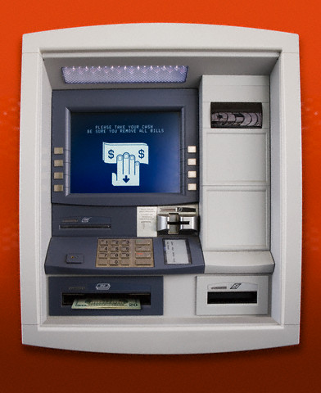
Short Term Memory
Closure
  Desire to complete or close the task in short term memory
ATM Cash Machine
  Closure
  Flush out STM
  Card/Cash ???
Introduction

Slide 11
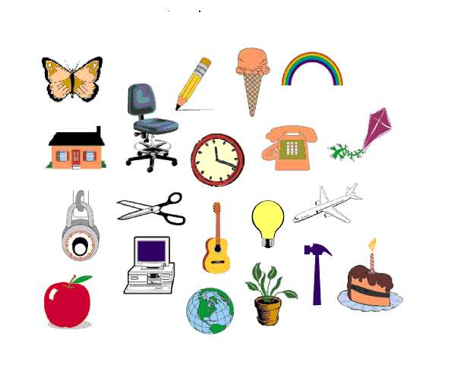
Short Term Memory
Introduction

Slide 12

Long Term Memory
Repository for all our knowledge
  Slow access ~ 1/10 second
  Slow decay, if any
  Huge or unlimited capacity
Introduction

Slide 13
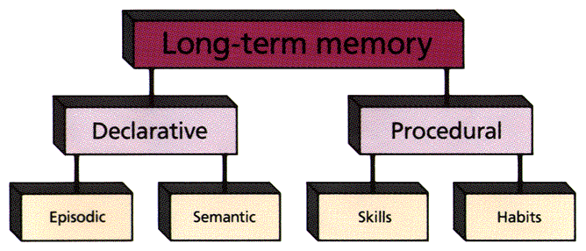

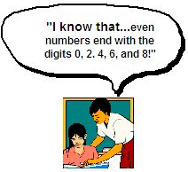
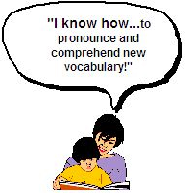

Long Term Memory
How to …..
Events and Experiences
Facts
Introduction

Slide 14

Reading Assignment
Long – term Memory structure
(HCI, Dix et al. Chapter 1)
Introduction

Slide 15
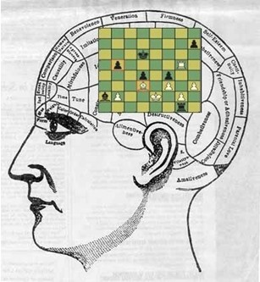
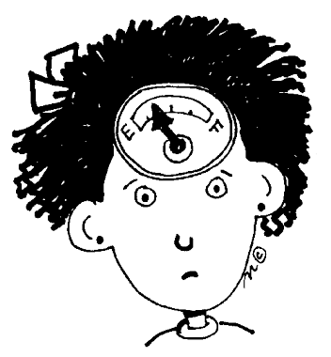

Long Term Memory - Processes
Storage
Forgetting
Retrieval
Introduction

Slide 16
Long Term Memory - Storage
Rehearsal
  Information moves from STM to LTM
Total time hypothesis
  Amount retained proportional to rehearsal time
Distribution of practice effect
  Optimized by spreading learning over time
Structure, meaning and familiarity
  Information easier to remember
Past, Faith, Idea, Cold, Value, Courtesy, Logic, Quiet, Ambitious
Boat, Tree, Cat, Child, Gun, Plate, Home, Table, Computer, Spoon
Introduction

Slide 17
Long Term Memory - Forgetting
Decay
  Information is lost gradually but very slowly
Interference
  New information replaces old: retroactive interference
    Recalling older telephone number
  Old may interfere with new: proactive inhibition
    Driving to old house
Introduction

Slide 18
Long Term Memory - Retrieval
Recall
  Act of reproducing a specific incident, fact or other item (from long term memory)
  Recalling where you were last weekend, fill-in-the-blank on exams
Recognition
  Information provided gives knowledge/cue that it has been seen before
  People are more likely to recognize a suspect in a police line-up than to provide an accurate description from recall memory
  It is easier to answer multiple-choice questions than essay questions because the correct answer may be recognized
People recognize more than they can recall.
Introduction

Slide 19
Lecture Contents
Introduction
Human
  Input/Output Channels
  Human Memory
  Thinking
Introduction

Slide 20

Thinking
Reasoning
Problem Solving
Introduction

Slide 21
Reasoning
Use the knowledge we have to draw conclusion or infer something new about the domain of interest
Deductive Reasoning
Inductive Reasoning
Abductive Reasoning
Introduction

Slide 22
Deductive Reasoning
Deduction:
  Derive logically necessary conclusion from given premises
    e.g. If it is Friday then she will go to work
    It is Friday
    Therefore she will go to work.
  Logical conclusion not necessarily true:
  e.g. If it is raining then the ground is dry
  It is raining
  Therefore the ground is dry
Introduction

Slide 23
Deductive Reasoning
When truth and logical validity clash …
  e.g. Some people are babies
  Some babies cry
  Inference - Some people cry
Correct?
Introduction

Slide 24
Inductive Reasoning
Induction
  Generalize from cases seen to cases unseen
Unreliable
  Can never prove it true
… but useful!
Humans not good at using negative evidence
  e.g. Wason's cards.
  e.g. All elephants we have seen have trunks
  therefore all elephants have trunks
Introduction

Slide 25
Inductive Reasoning
Wason’s Cards
7 E 4 K
If a card has a vowel on one side it has an even number on the other
Is this true?
How many cards do you need to turn over to find out?
…. and which cards?
Introduction

Slide 26
Inductive Reasoning
Wason’s Cards
Common Responses
  Select E & 4: Positive Evidence
Check Negative Evidences
  Select E & 7
7 E 4 K
If a card has a vowel on one side it has an even number on the other
Introduction

Slide 27
Abductive Reasoning
Reasoning from event to cause
Unreliable
  May lead to false explanations
  e.g. Sam drives fast when drunk.
  If I see Sam driving fast, assume drunk.
Introduction

Slide 28
Problem Solving
Reasoning: Inferring new information from what is known
Problem Solving: Finding solution to unfamiliar task using knowledge
Several theories
  Gestalt theory, Problem space theory
Analogy
  Mapping: Using knowledge of similar problems/domains
Skill Acquisition
  Driver, Player, Surgeon
Introduction

Slide 29

Errors and Mental Models
Two Types of Errors
Mistakes
  Errors in choosing an objective or specifying a method of achieving it
  Causes: Incorrect understanding
  Humans create mental models to explain behaviour
  If the model is wrong (different from actual system) errors can occur
Slips
  Errors in carrying out an intended method for reaching an objective
  Causes: Poor skill, inattention etc.
  Changes in the skilled behaviour: Driving home, left/right hand traffic
Introduction

Slide 30

Emotion
Implications for Interface Design
  Stress will increase the difficulty of problem solving
  Relaxed users will be more forgiving of shortcomings in design
  Aesthetically pleasing and rewarding interfaces will increase positive affect
Introduction

Slide 31
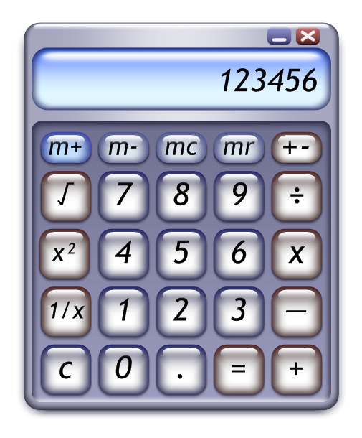
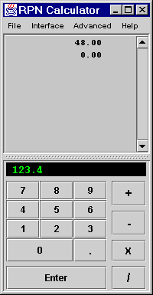
Emotion
Introduction

Slide 32
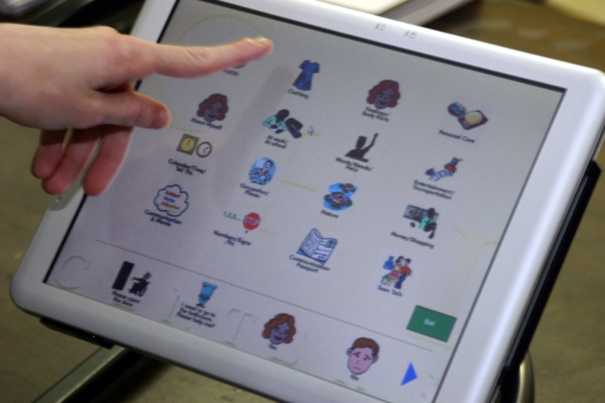
Individual Differences
Long term
  Gender, physical and intellectual abilities
Short term
  Effect of stress or fatigue
Changing
  Age
Ask yourself
  Will design decision exclude section of user population?
Introduction

Slide 33

Humans as information processors
Input from environment (I/O)
Store, manipulate and use information and reacting
Information received through senses
Stored in Memory (Short Term / Long Term)
Use memory in reasoning and problem solving
Recurrent familiar situations allow people to acquire skills in particular domain
Can be error when changed.
Introduction

Slide 34

References
Human Computer Interaction by Dix et al.
User Interface Design and Implementation, Prof. Robert Miller - MIT
User Interface Hall of Fame/Shame
Introduction

